Slide 1
Prison Break
By: Travis Samford

Slide 2
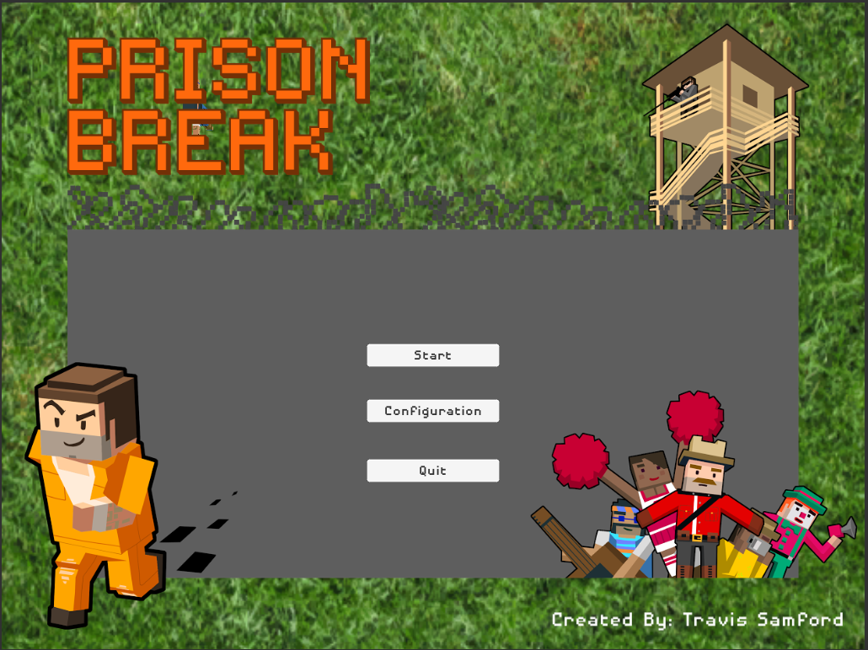

Slide 3
Outline
Game Mechanics
What you will be doing
Sample Instruction Scene

Slide 4
Game Mechanics
Prison break is a Shooting game
Each level will have a different target it is random.
Shoot as many targets as you can before the time runs out.
Shoot the right targets fast enough in a row, and the multiplier goes up.
Shoot the wrong target and the multiplier resets.

Slide 5
This is what you will be doing
Enter Name
Four Levels (Repeat this 4 times)
Review level instructions
Play Level
Get score
Take QUIS survey on paper handed to you
Take Final QUIS survey on paper handed to you

Slide 6
